Slide 1
Knowledge Management & Innovation-2
Eunika MERCIER-LAURENT
Knowledge & Innovation Management
Research Center Université Lyon 3/CReSTIC Reims
eunika@innovation3d.fr
http://innovation-ecosystems.eu

Slide 2
KM in practice
Tool oriented
User’s activity oriented
Management oriented
Innovation process management
Leadership management
Well-being
Sustainability, CSR
Notes:
Classic IT has invented
quality - strategy understanding

Slide 3
KM - principle
Initiatives
Methods: organization and implementation
Bottom-up
Top down
Tools
Benefits
Principle: computer = intelligent assistant of human

Slide 4
KM « Recipy »
Understand
Context
What, why, who… – needs
Nature of knowledge - model
Choice of tool(s) vs hybrid
Incremental (do small think global), or
Top-down?
MEASURES of progress

Slide 5
Influence of AI
Way of thinking
Knowledge modeling for reuse(Kbblocs) and processing (Kbrain)
Reasoning
Discovery
Problem solving (DSS)

Slide 6
Agenda
Introductions
Knowledge Management
definitions, origins and dimensions
KM Methods
Projects:
Understand KM ways (case analysis)
Apply
Innovation
Overview
Knowledge4Innovation and Sustainability
ICT for KM and Innovation
Traditional
AI
Projects presentation
Feedback

Slide 7

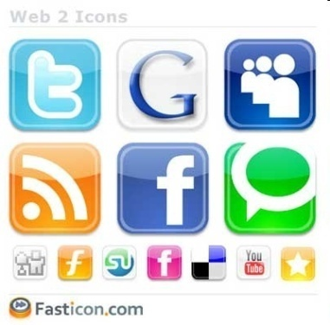



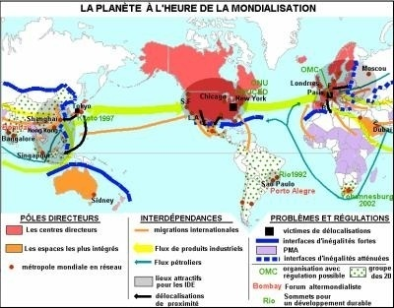


Innovation - Context

Slide 8
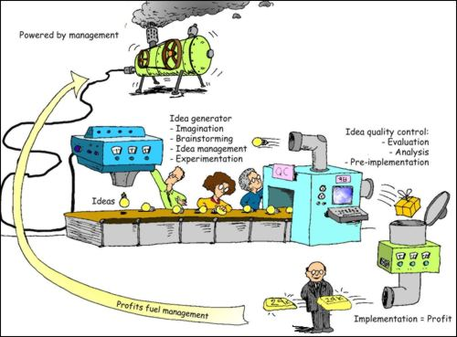

Innovation
From idea to sustainable success of all participants (EML)
Needs
Clients, Partners
Knowledge Market Technology Competitors
Kflow, Virtual Networks, ICT, Intelligent Autonomous Systems
Impact on environment

Slide 9


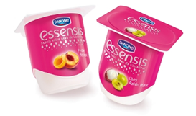
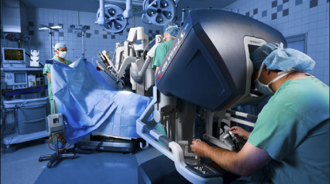
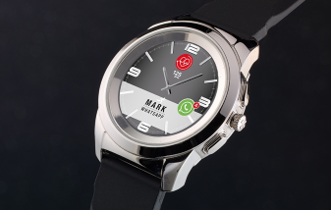
Innovation
Incremental
Disruptive

Slide 10
Innovation
Close
Participative
Open
Global

Slide 11
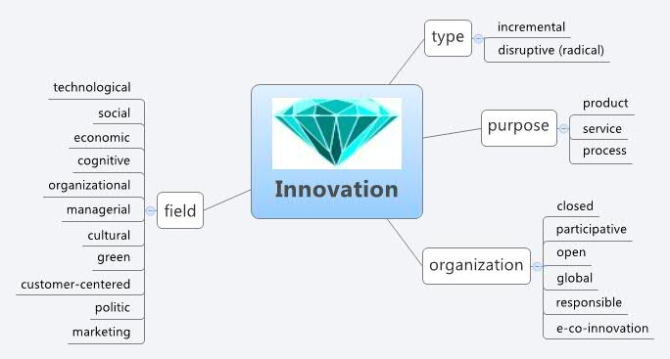
Innovation
societal

Slide 12
Innovations
Focus on R&D
Focus on technology
Collaborative innovation
Eco-innovation
Biomimetics?
All innovation needs knowledge to succeed

Slide 13
An old (?) definition
innovation meets five main criteria:
the manufacture of a new good,
introduction of a new production method or of new means of transportation,
implementation of a new organization,
opening a new market
and the conquest of a new source of raw materials
Joseph Schumpeter 1911

Slide 14
Innovation
Creation, evolution, exchange and application of new ideas
into marketable goods and services for:
the success of an enterprise
the vitality of a nation's economy
the advancement of society
www.innovationecology.com/papers/in%20search%20of%20innovation.ppt

Slide 15
From idea to success
John Kao https://www.youtube.com/watch?v=LJG2Z8UXui0
White House https://www.youtube.com/watch?v=DFfxIhM1Pko
Condition for success https://www.youtube.com/watch?v=zX7I_Rw8Q0I

Slide 16
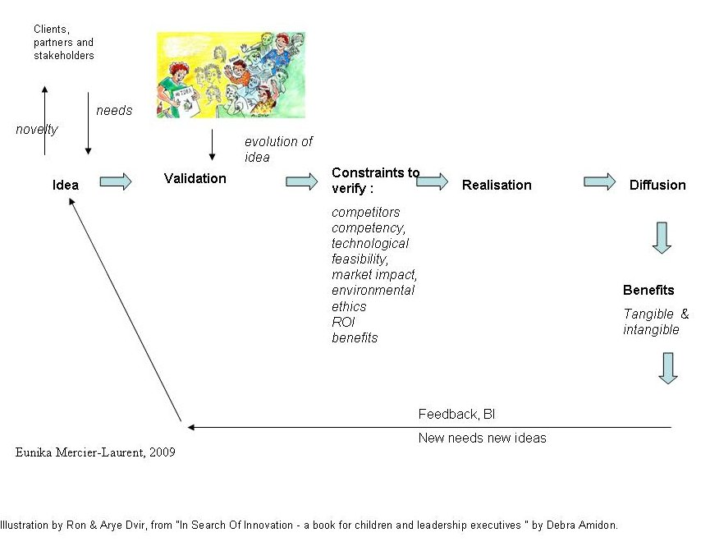
Innovation process

Slide 17
Innovation ?
From idea to sustainable success of all participants (EML definition)
More definitions on entovation.com
2 steps : creativity & transformation
Sustainable success

Slide 18

Innovation
Creativity
https://www.youtube.com/watch?v=zO2LdDpx-Tc
What are the conditions for creativity can happen ?

Slide 19
Creativity methods
Brainstorming
Innovation café
TRIZ https://www.youtube.com/watch?v=ouWWuwW21ZI
https://www.youtube.com/watch?v=MxOGaB4OgYc
De Bono lateral thinking - 6 hats
Short http://www.youtube.com/watch?v=Rwu1YlveU_4
https://www.youtube.com/watch?v=maWEAnSegcc
Conf https://www.youtube.com/watch?v=e20lpMyXFj4

Slide 20
Co-creation
Innovation with client D. Amidon (1989)
Design thinking – innovating with client
https://www.youtube.com/watch?v=vQytKCT563I
In IT: Extreme programming, needs discovery
Condition for success: share benefits

Slide 21
Project 2a – apply KI to traditional IS
Improving existing (ex. your case study)
Introducing KI in a company
Smart & green programming
Innovation management system
KM for global security (exploration of all sources: social networks, video…)
Intelligent e-commerce
Best practices management system
Kbase for sustainability
…

Slide 22
Project 2 a - KM &Innovation applied to existing IS
Follow KM recipe
Understand
Context (existing applications and knowledge flow)
What, why, who… – needs
Nature of knowledge - model
Choice of tool(s) vs hybrid
Incremental (do small think global), or
Top-down?
MEASURES of progress
Discovery of needs (innovation)

Slide 23
Project 2b – succeed a start-up (1)
Main steps “from idea to success”
Find an idea (creativity methods) – needs/market
Write all ideas on Innovative ideas page on your wiki (wiki – collaborative work)
Collect Knowledge & competency (K organization)
Evaluate impacts
Check ingredients for success

Slide 24
For all groups
Create your project page on class collaborative space
Participants names (4 persons max/groups)
Describe your project following related »recipy » (a or b)
Presentation May?
Presentations schedule

Slide 25
Project 2b – Apply KM to succeed your start-up
Innovative ideas connecting need, challenge and technology
Prevention
Disaster management
Climate change
…
Some challenges on innocentive.com

Slide 26
Your project b: some tips
Clear and simple idea
What industry or market you plan to target
What type of corporate organization you’ll implement
Where your business will be located
How to manage related risk
…
.

Slide 27
Pitch
What is your presentation about? - what’s your idea?
What does your start-up or product do?
Who need this and why?
What knowledge/know-how you need to succeed?
Ex Silicon Valley tv serie

Slide 28
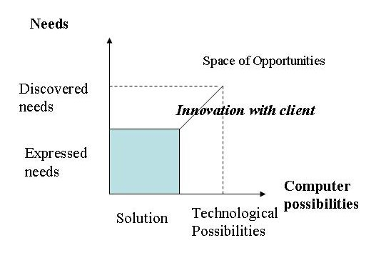
Needs engineering

Slide 29
Your project (b): Innovative Company – KM
What knowledge you need to succeed?
Context?
Competitors and possible partners (BI)
Market ?
Skills and connections ? Laws & taxes
Choice of Business models
Communication – when and how
Funding
…

Slide 30
Your project: Innovative Company – knowledge?
Skills, experience and connections
What skills are vital to succeed?

Slide 31
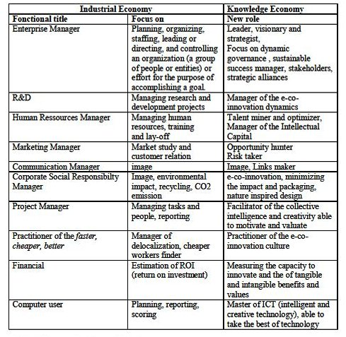

Slide 32
Business models – sales methods only
Shops and e-commerce
Gillette & HP
Google
Open source
e-newspapers
Groupon
Crowdsourcing An entrepreneur (or anyone, for that matter), posts a project online, asking for funds. People then pledge as much money as they like towards the project. They only have to part with their cash if the entrepreneur raises their predefined funding target.
Ex http://www.mymajorcompany.com/
Your business model ?

Slide 33
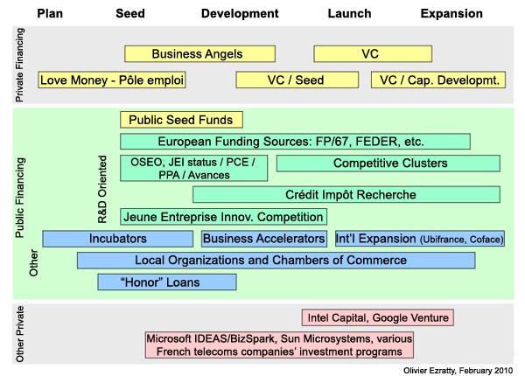
Funding

Slide 34

Funding
http://ec.europa.eu/horizon2020
https://www.eurostars-eureka.eu/
French-Indian research http://www.frenchsciencetoday.org/index.php?option=com_content&view=article&id=17&Itemid=75
France US, Denmark, Japan…(embassy and join programs)

Slide 35
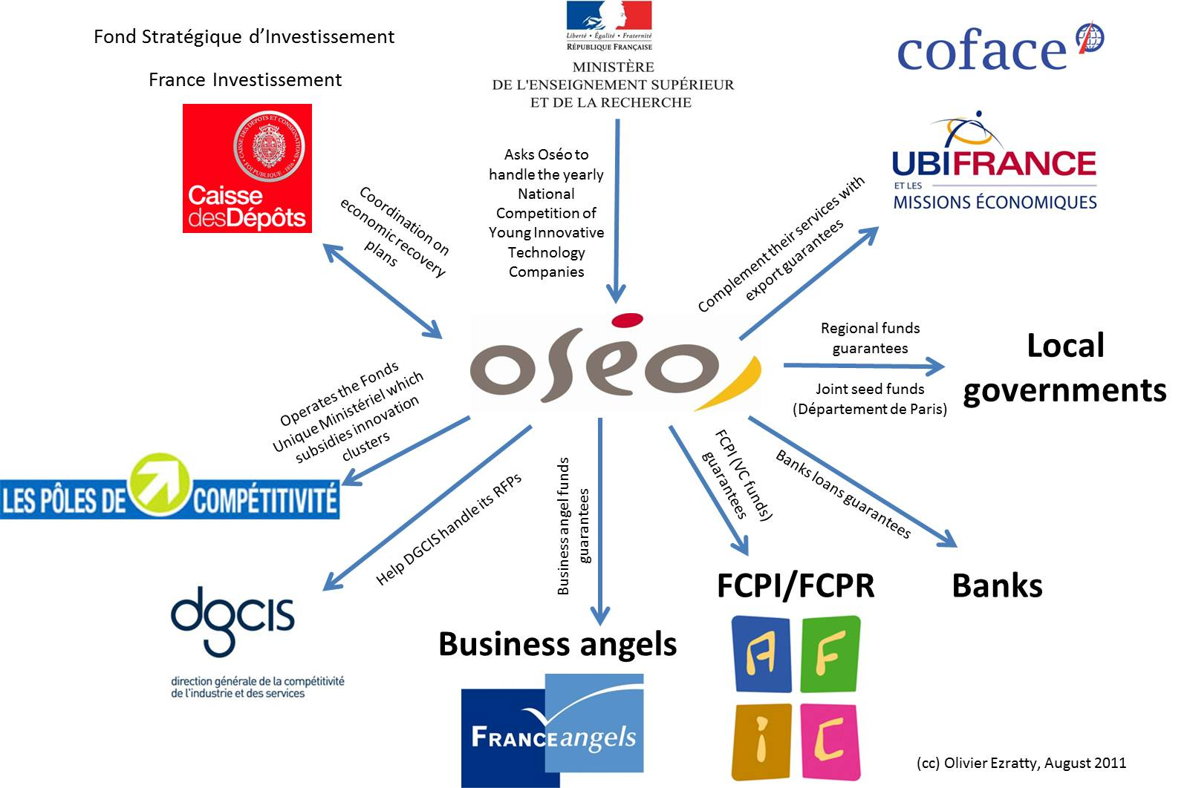
Funding in France

Slide 36
Funding in France
Main sources for project funding in France *Ministry of research contest http://www.enseignementsup-recherche.gouv.fr/pid24633/concours-national-d-aide-a-la-creation-d-entreprises-innovantes.html *http://www.leconcoursdelacreation.fr/ *http://www.bpifrance.fr/Recherche/%28text%29/financement-entreprise-innovante.htm *http://www.f-iniciativas.fr/autres-services/jeune-entreprise-innovante-jei (just exemption from taxes)

Slide 37
Funding in France
* Orange Fab http://www.orangefab.fr/ in the US and in France *http://www.investessor.fr/ *http://www.franceangels.org/fr/les-business-angels.html *http://parisbusinessangels.com/ *incubators http://incubateurs.parisregionlab.com/ see group on LinkedIn Paris Region Business Community Partnership big-small http://www.pactepme.org/ http://www.agence-nationale-recherche.fr/en/project-based-funding-to-advance-french-research/ See also ADEME, they sponsor projects related to environement http://www.ademe.fr/

Slide 38
Your project 2b: “Innovative Company” on class wiki
Team (role of each of you and why)
Idea & Project description (art of) + name & logo
Competitors and your +
What market you address and why
Business model and sales methods (IPR?)
Funding
Communication
8D Impact (tech, economic, environmental, cognitive, social, cultural, political, health)

Slide 39
Think about
Vision
Strategy
Tactics

Slide 40
KM&I in your project
Innovation process
Creativity – ideas – your dreams & collective knowledge knowledge about existing
Transformation (co-creation)
Success (tangible & intangible values)
Knowledge
Organized knowledge inside and outside

Slide 41
Conditions for success
Innovation culture :
Way of Thinking and Acting
« reflexes »

Slide 42
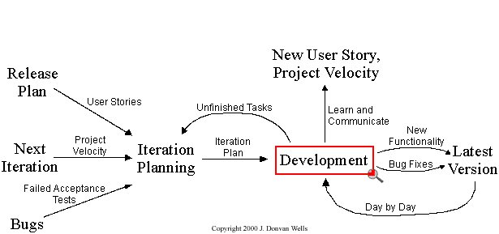
Extreme programming

Slide 43
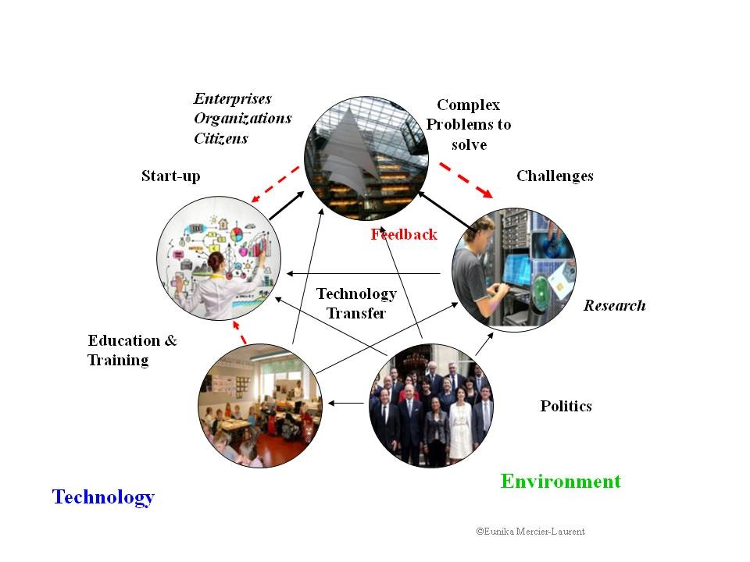
Context

Slide 44
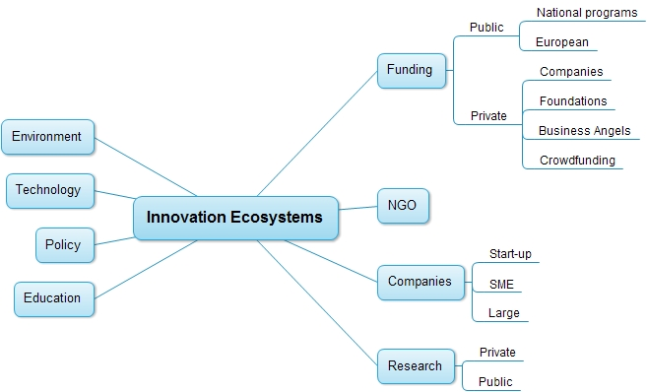
Innovation ecosystems

Slide 45

Out of the box thinking – connecting all the dots
You can only use straight lines and you can’t lift up your pen

Slide 46
“Think different” capability
Global
Systems

Slide 47
Knowledge Holonomy
https://en.wikipedia.org/wiki/Holon_(philosophy)
Society
5
Town, Region
Community of Interest
Professional Association
4
Companies, Universities,
Organization
Enterprise
3
Project
2
Functions, Teams,
Disciplines, SIG’s,
Community of Practice
Individual (knowledge cultivator)
Employees, Suppliers,
Customer, Stakeholder,
Partner
1

Slide 48

Culture of « knowledge cultivator »
KIS®
Sustainability
Sharing K&E
Business Intelligence
RT Learning 3W
“Best practice”
Collaboration
Innovation 3E
Thinking without boarders
Opportunity hunting
Common language

